Slide 2
Working with harmonized LUCAS dataset
Instructors: Lukáš Brodský, Martin Landa, Tomáš Bouček
lukas.brodsky@fsv.cvut.cz martin.landa@fsv.cvut.cz tomas.boucek@fsv.cvut.cz
https://gitlab.com/geoharmonizer_inea/odse-workshop-2022/

Slide 3
Land mapping
Map land cover and / or land use;
Pure land cover components (INSPIRE);
Map changes of land cover and / or land use (2006, 2009, 2012, 2015, 2018);
Land management (ploughing, crop residues, grassland grazing; harvested field, tilled/sowed, clear cut, burnt area, fire break, nursey, dump site, temporary dry, temporary flooded);
Land special status (protected, hunting, protected and hunting, no special status) ;
Water management (irrigation, type and source, delivery system);
Study soils (erosion, etc.);
Tree properties (height of trees, height of trees at maturity);
Evaluate Copernicus Land Cover (urban areas, percentage of: imperviousness, coniferous forest trees, broadleaved forest trees, shrubs, herbaceous plants, lichens and mosses, consolidated bare land, unconsolidated bare land);
Map habitat complex types following EUNIS;

Slide 4
Content
LUCAS dataset background
Accessing LUCAS online (Python API - Jupyter notebook, QGIS)
Use case: land cover validation with LUCAS
LUCAS land cover nomenclature translation
Software needed: Google colab & ST_LUCAS package & QGIS (plugin)

Slide 5
LUCAS dataset (Eurostat)
LUCAS stands for the Land Use and Coverage Area frame Survey.
Main goal: identify changes in the European Union in land cover and land use.
Such information aim to be used in: nature protection, forest and water management, urban and transport planning, agricultural policy, prevention and mitigation of natural hazards, soil protection and mapping, monitoring climate change, monitoring biodiversity, etc.
LUCAS provides real and unique ground-true data for land products validation and new models calibration.

Slide 6
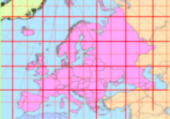
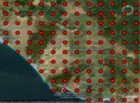
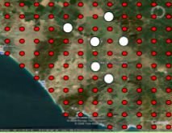
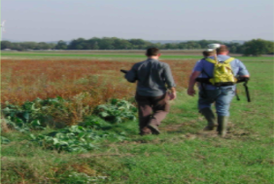
LUCAS survey
phase: sample
for stratification from 2 km grid
Land Cover:
classes ..
2. phase: in-situ data collection
3. Quality assurance

Slide 7
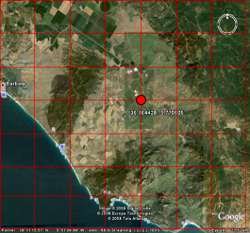
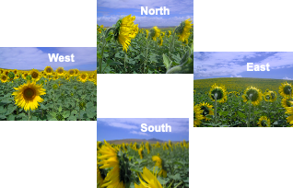
LUCAS survey
Surveyors examine:
land cover and land use, management,
structural elements in the landscape
and take 500 gram topsoil sample (at one out of 10 points)
and collect photos.

Slide 8
LUCAS dataset
Year | EU countries | Points
2006 | 11 | 168 402
2009 | 23 | 234 623
2012 | 27 | 270 272
2015 | 28 | 339 696
2018 | 28 | 337 854
General info:
Covers EU countries
Grid 2x2 km
Total 1.3 MIO points!
2006 -> 2018 (next 2022)
LUCAS project evolves since 2006;
=> need of harmonization!

Slide 9
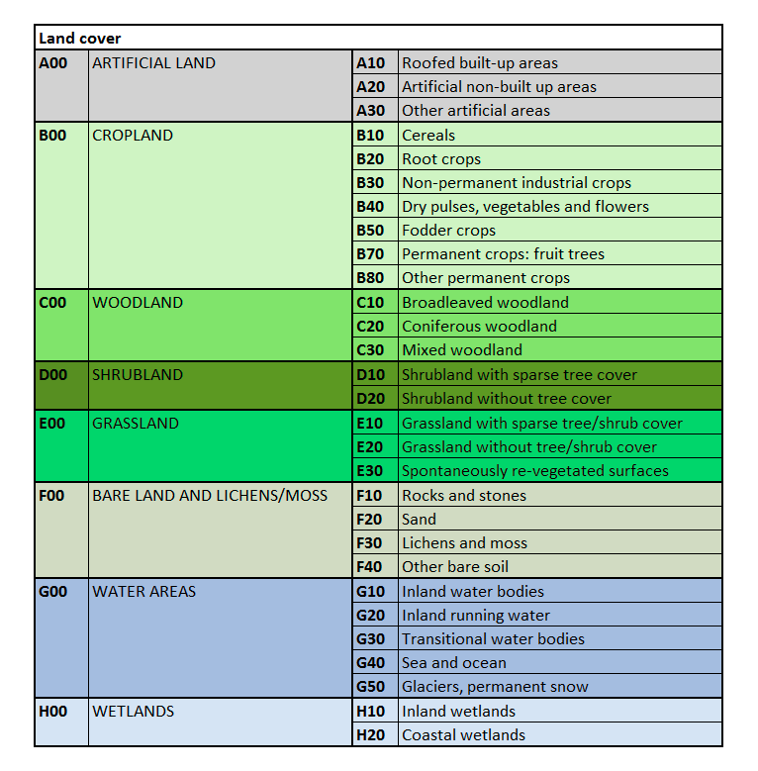
LUCAS land cover nomenclature
fully hierarchical (3 levels)
lc1: 76 classes

Slide 10
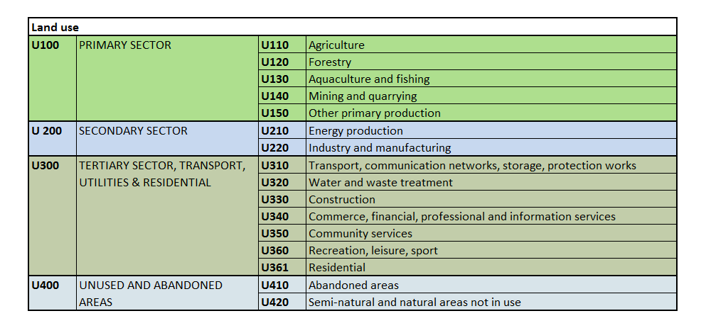
LUCAS land use nomenclature
lu1: 41
classes

Slide 11
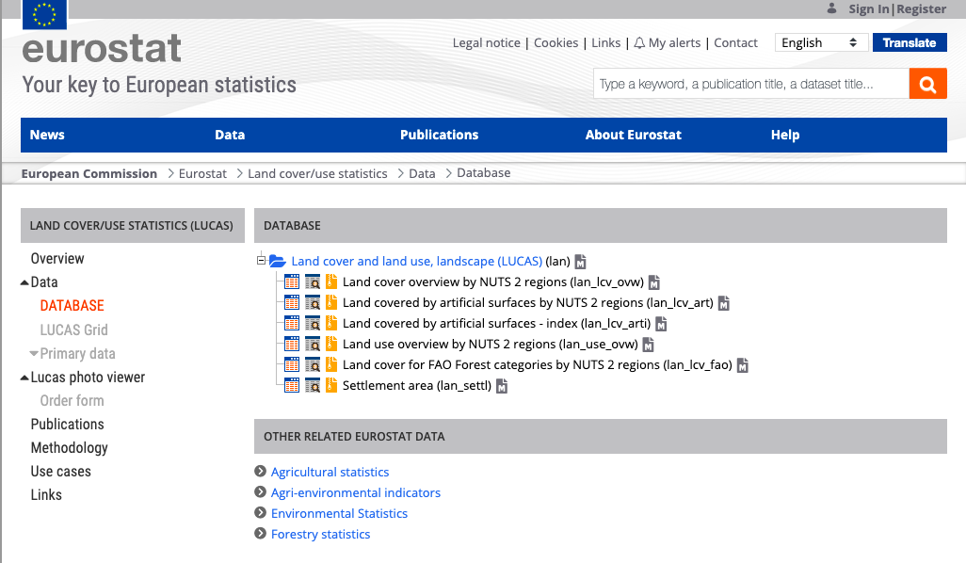
LUCAS access https://ec.europa.eu/eurostat/web/lucas

Slide 12
Working with LUCAS dataset
1. Download *csv file from Eurostat primary data source
2. Create database
3. Import data (one year, multiple years)
4. Harmonize:
Attributes
Attribute names
New definitions (continuous variables vs. categorical)
Data types (string vs. integer)
No valid data: 8
Geometries
Spatoitemporal aggregation

Slide 13
Or use ST_LUCAS system
User 1: working Python environment => use ST_LUCAS Python API (DEMO) and get the data online;
User 2: working in GIS (QGIS) => use ST_LUCAS QGIS plugin and get the data online (DEMO);

Slide 14
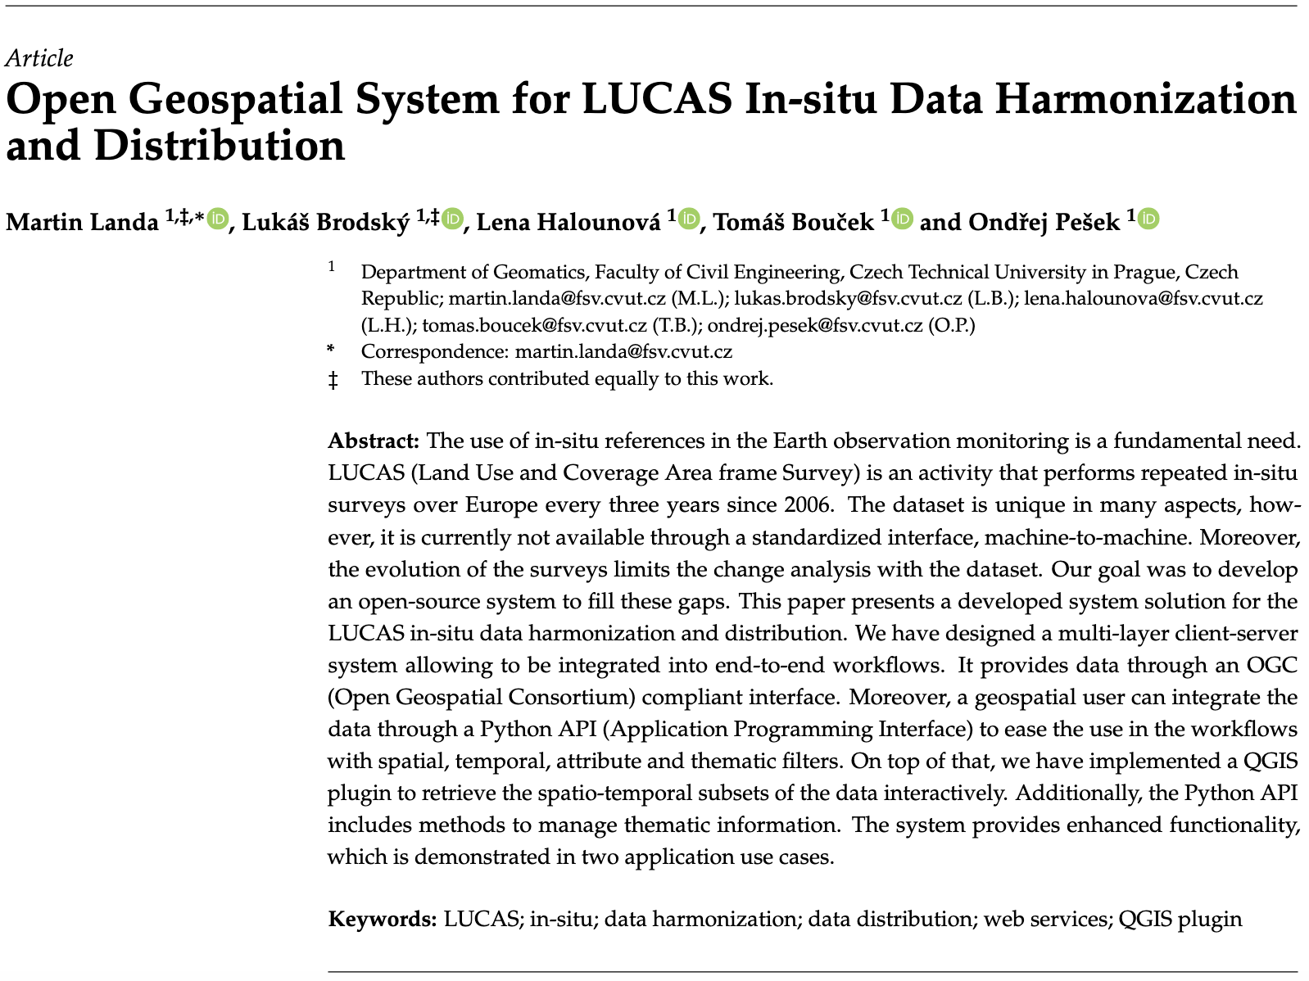
LINKS:
https://gitlab.com/geoharmonizer_inea/st_lucas
https://geoforall.fsv.cvut.cz/st_lucas/

Slide 15
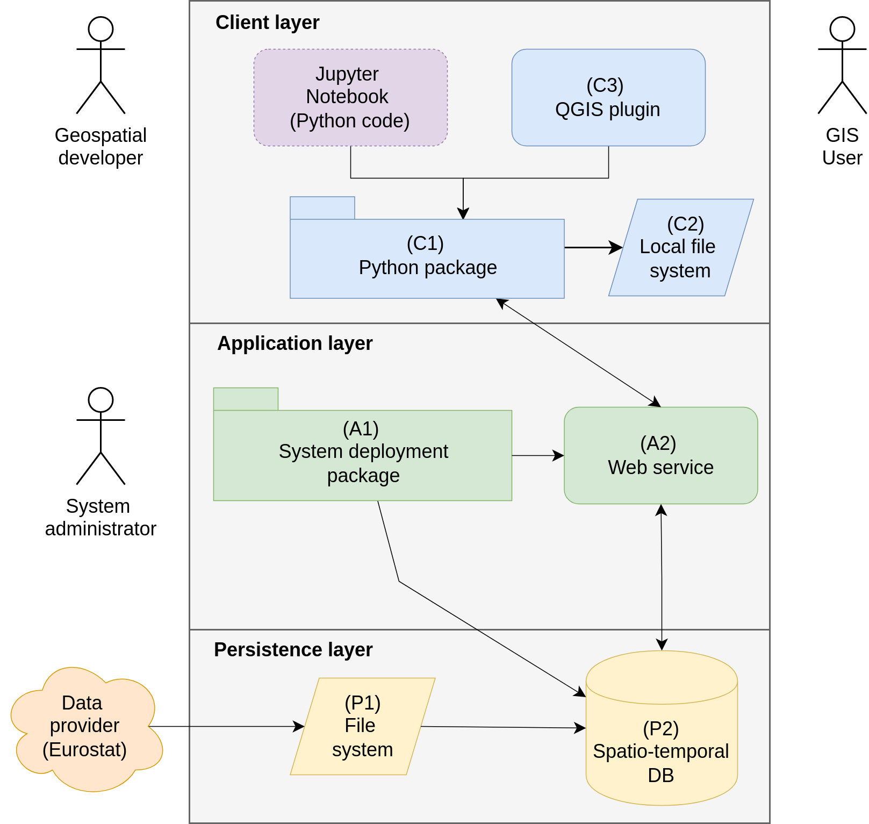
ST_LUCAS
ST_LUCAS system’s static
high-level architecture

Slide 16
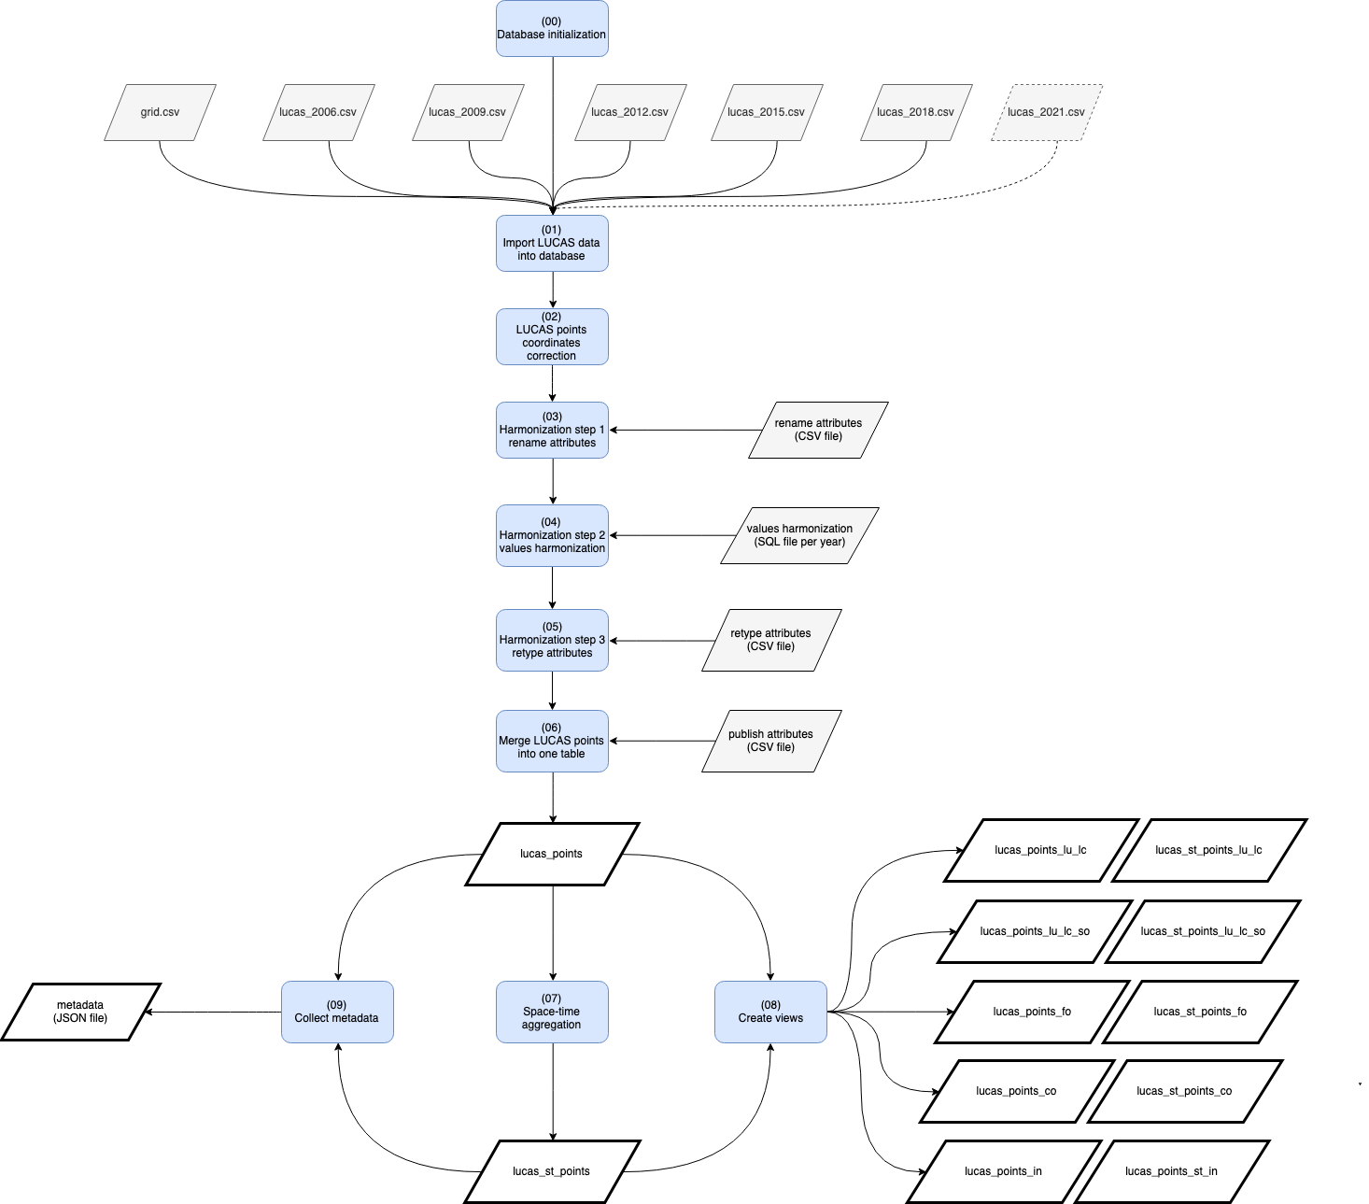
ST_LUCAS
harmonization
1. import primary data
(2006 -> 2018)
2. coordinates correction
3. rename attributes
(reference 2018)
4. values harmonization
5. re-type values
6. merge into one table
7. space-time aggregation
=> distribute

Slide 17
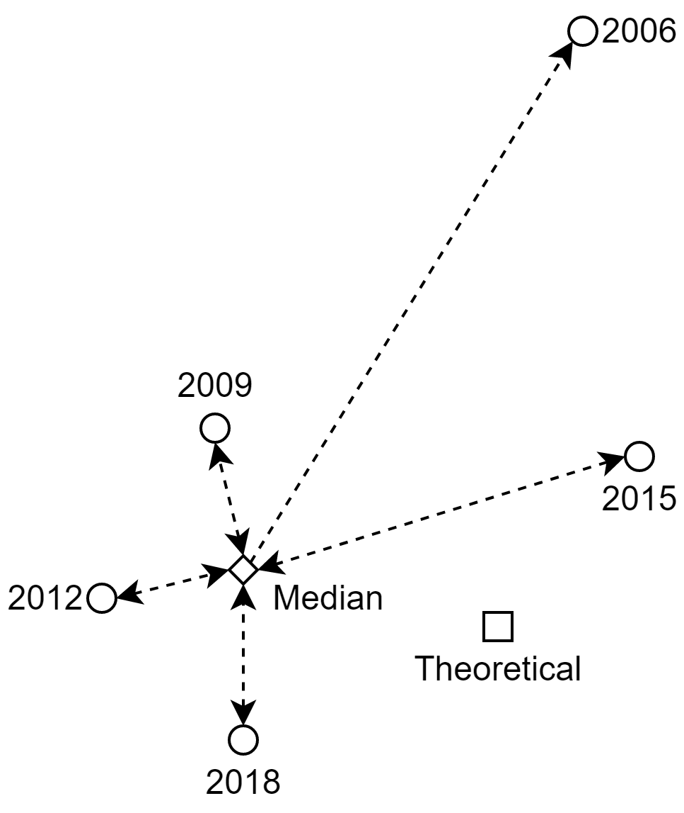
ST_LUCAS
harmonization
LUCAS geometries harmonization
for change detection

Slide 18
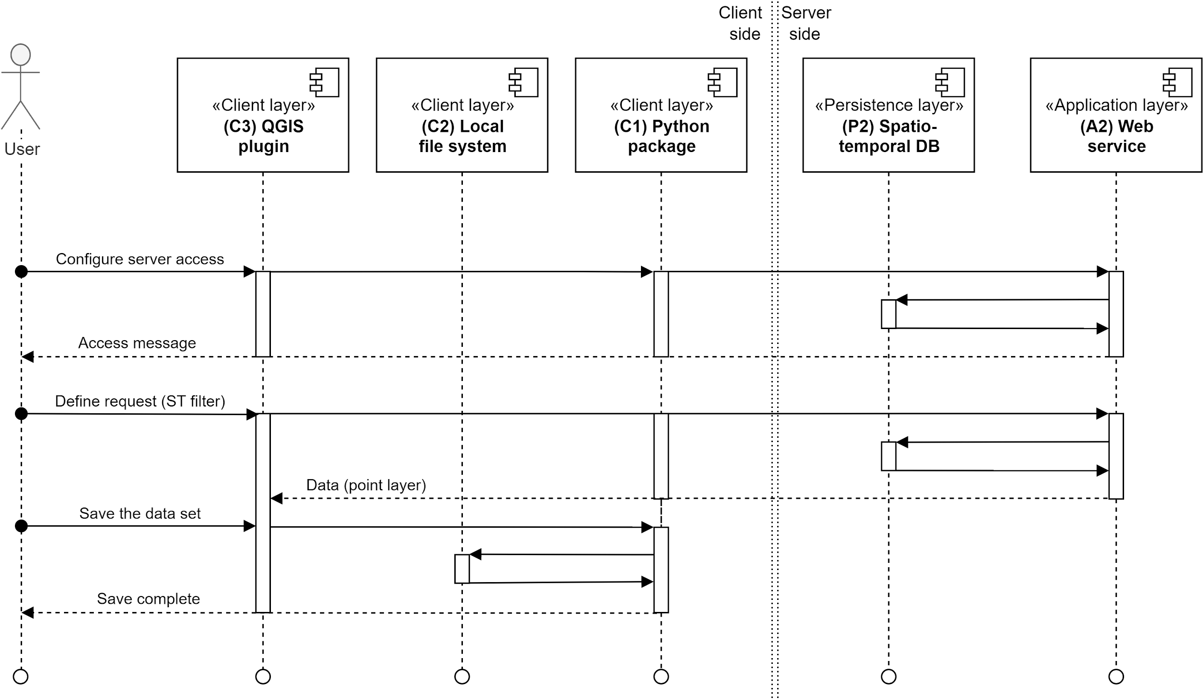
ST_LUCAS system interaction

Slide 19
ST_LUCAS system
General info: LUCAS data grouped thematically
LC_LU: land cover and land use
LC_LU_SO: land cover and land use & soil
FO: forestry
CO: copernicus
IN: inspire

Slide 20
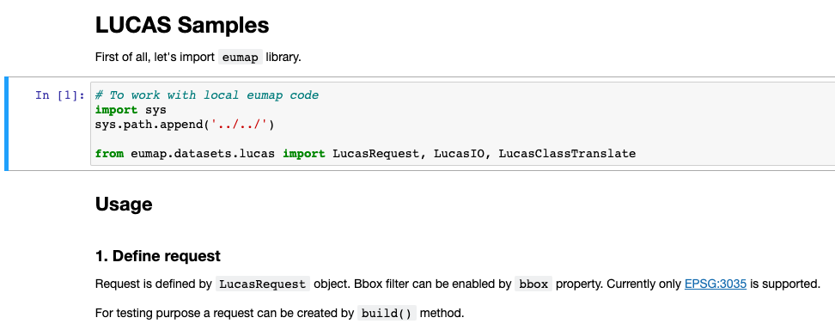
Hands-on #1: accessing ST_LUCAS dataset using Python API
Notebook:
https://gitlab.com/geoharmonizer_inea/odse-workshop-2022/ 01_lucas_access.ipynb

Slide 21
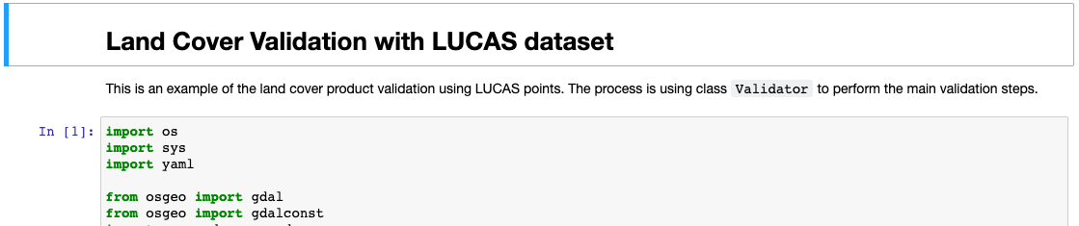
Hands-on #2: LC validation with LUCAS
Notebook:
https://gitlab.com/geoharmonizer_inea/odse-workshop-2022/
General steps:
1. prepare land cover product: ./sample_land_cover/cz_land*.tif
2. prepare LUCAS points for the AOI: ./sample_land_cover/cz_lucas*.gpkg
3. run validation in Jupyter notebook: 02_land_cover_validation.ipynb
4. discuss the results

Slide 22
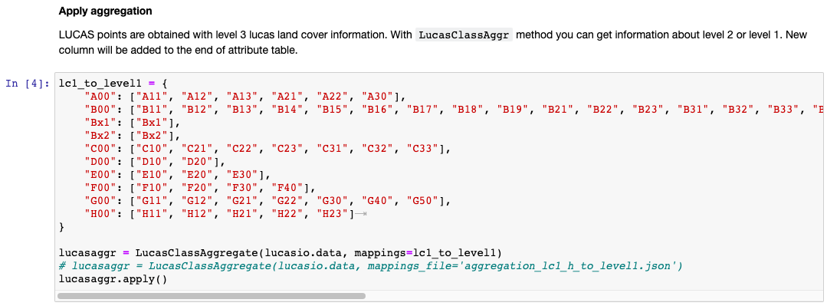
Hands-on #3: Nomenclature translation
Notebook:
https://gitlab.com/geoharmonizer_inea/odse-workshop-2022/ 03_lucas_analyze.ipynb

Slide 23
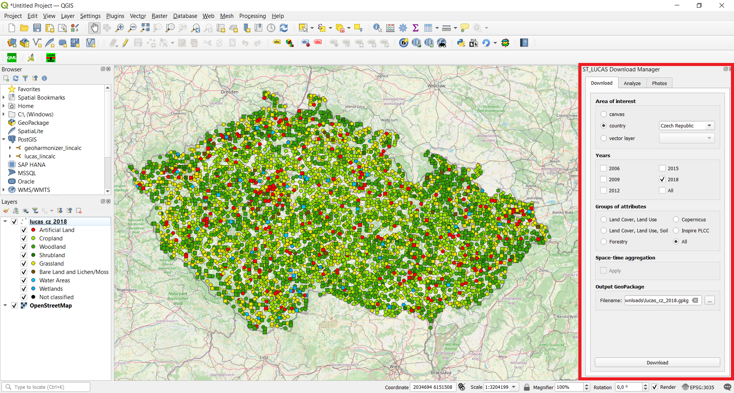
Hands-on #4: LUCAS QGIS plug-in
QGIS plugin needs to be installed!
https://gitlab.com/geoharmonizer_inea/st_lucas/st_lucas-qgis-plugin

Slide 24
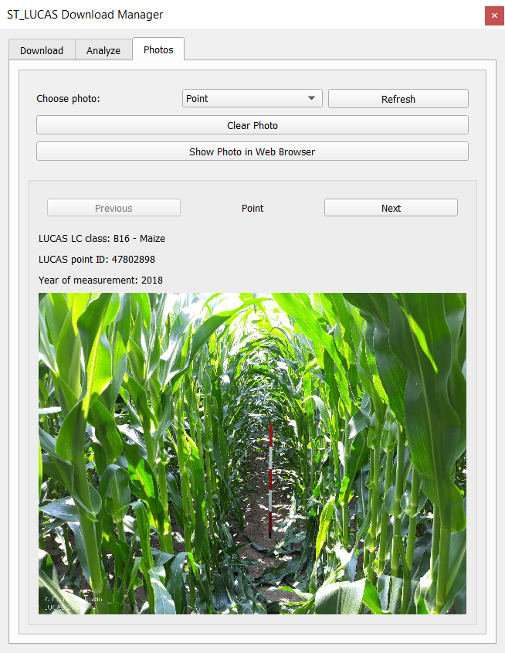
Hands-on #5:
LUCAS QGIS plug-in

Slide 25
Wrap-up LUCAS session
Learned how to:
Access the harmonized LUCAS dataset with Python API and QGIS;
Filter the subsets;
Use LUCAS for land cover validation;
and it can be used the same way for land cover model calibration!;
Translate LUCAS nomenclature to e.g. CORINE;
Aggregate the land cover classes before validation / calibration;
in order to perform land cover research with open data and open
software!
Thanks for your attention!
USE LUCAS DATA FOR YOUR RESEARCH!

